Slide 1
IBE-BIV Seminar
28 Sept 2023
Charlotte De Mey
Sector Relations Expert

Slide 2
Who is NBN?
NBN is an agency of the federal government.
Our mission is to:
Develop Belgian (NBN), European (EN), international standards (ISO) and ensure the voice of the Belgian interests is heard
Stimulate the use of standards
Develop solutions for easy and effective access to standards

Slide 3
Who is NBN?
>750
COMMISSIONS
+50.000
STANDARDS
3.000
BELGIAN EXPERTS
3.000
NEW STANDARDS PER YEAR
3

Slide 4
NBN smoothly guides Belgian companies and other stakeholders to best practices. And this in every possible domain.
We focus on four pillars:
creating knowledge
using knowledge
acquiring knowledge
sharing knowledge.

Slide 5
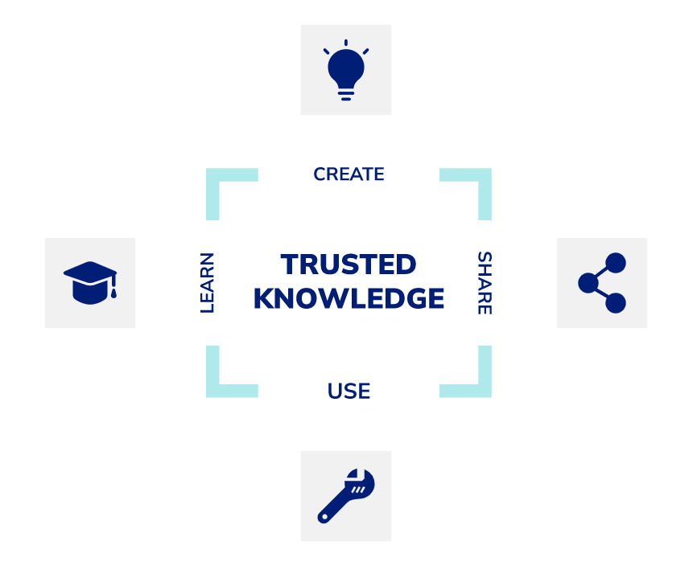
Bringing together specialists from companies, organisations, governments and education to work on best practices in all sectors.
To familiarize yourself with the vast and exciting world of management systems, NBN offers training courses.
Those who like to help develop standards can take an expert training course.
Bringing professionals and specialists together to exchange knowledge and experience: it is a strength of NBN. Every year we organize inspiration and networking events, webinars and seminars to which everyone is welcome.
The online standards platform gives access to NBN's huge catalogue of knowledge documents. You quickly and easily consult the latest standards, tailored to your organisation.
5

Slide 6
Why participate in standardisation?
Benefits of participation
Gaining first-hand knowledge: Learn about future technological developments and trends.
Influencing the standards development process: This allows a company to protect its investments in products and research & development.
Building a local network: Belgian standardisation committees are the ideal meeting place to develop new contacts and exchange ideas.
Building an international network: Participating in TC or WG allows you to build international contacts.

Slide 7
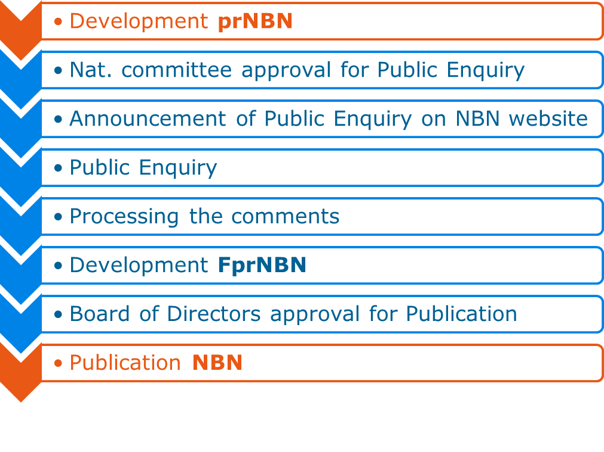
NBN standardisation process
Publication of a purely Belgian standard after new Royal Decree

Slide 8
NBN standardisation process
Timeframe

Slide 9
Conclusions
Benefits of the new Royal Decree
Public inquiry time reduced from 5 months to 2 months.
No more publication in the Belgian Official Gazette. Only approval of the NBN Board of Director needed to announce and publish on NBN website.
Don’t hesitate to ask for revision of Belgian standards!
Link to the new RD: https://www.ejustice.just.fgov.be/cgi/article_body.pl?language=fr&caller=summary&pub_date=21-02-15&numac=2021020310

Slide 10
Thank you!
www.nbn.be
Charlotte De Mey
Charlotte.de.mey@nbn.be
www.nbn.be

