Slide 1
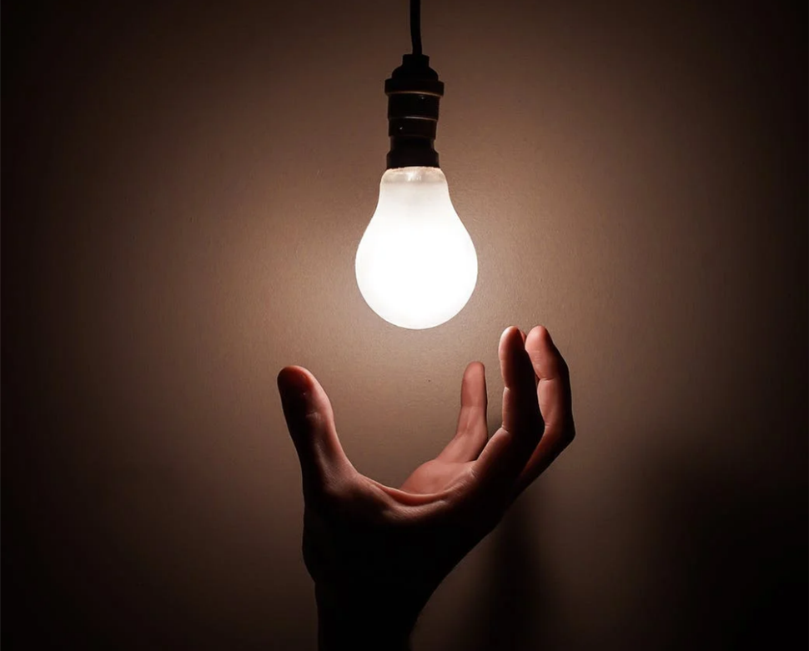
Gert Roeckx
CEO Signify Belux
Notes:
With a twist of the wrist, we can solve a lot of challenge we are facing in the world. Just by changing a lamp.
I hope I can inspire you today of how light can contribute to a greener & smarter world.
My Name is Gert Roeckx, CEO of Signify belux. Signify, better known as Philips Lighting. We changed our name 5 years ago, the moment that Royal Philips sold more than 50% of the shares of Philips Lighting. We are still using the brand Philips on our products in the stores.

Slide 2
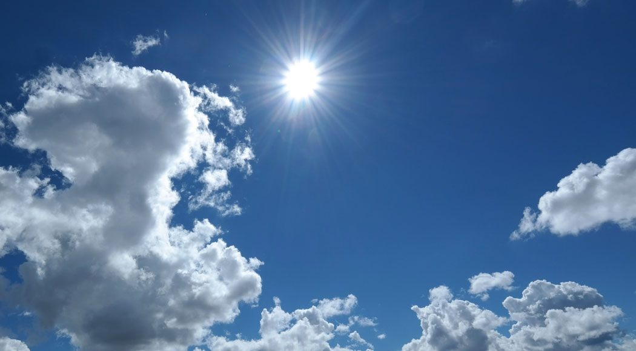
Notes:
Daglicht is onze beste licht gever, toch zien we dat licht brand op momenten dat er veel daglicht binnen valt, of zien we licht branden als er geen mensen zijn…..

Slide 3
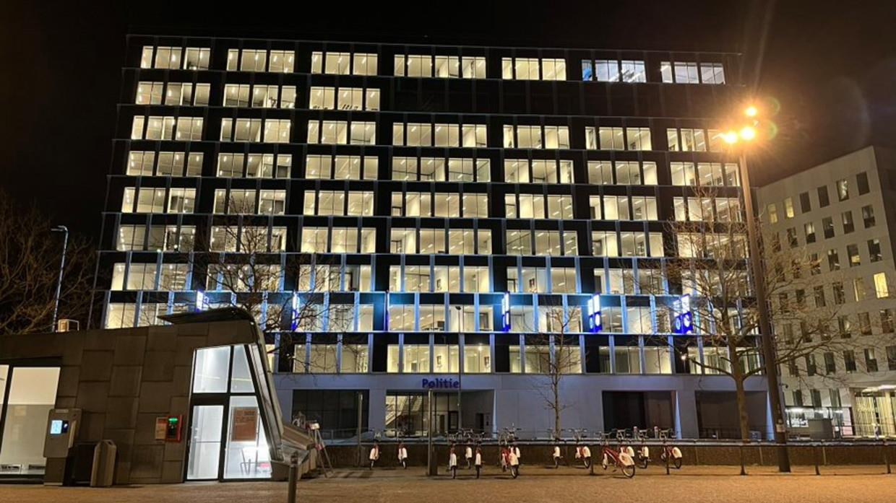
Notes:
En zie ik regelmatig nog dit! Midden in de nacht, geen werkende mens te zien in de gebouwen en toch brandt het licht. Bedrijfskantoren maar ook publieke gebouwen, scholen, etc.
Er wordt al heel veel gedaan om energie te besparen. Toch zien we nog te veel gebouwen die onnodig verlicht zijn.

Slide 4
Challenges
Cities face a lot more challenges next to regulations and norms in public buildings
Green procurement
Energy consumption
War for talent
Costs
Sustainability ambitions
Flexible working
Regulations
Etc…

Slide 5
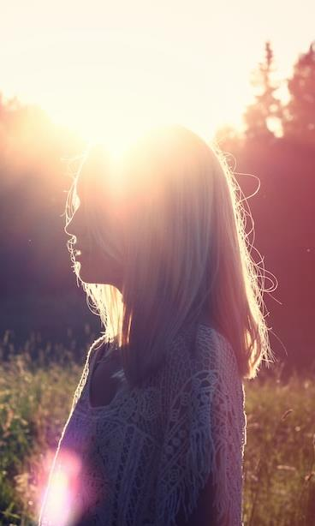
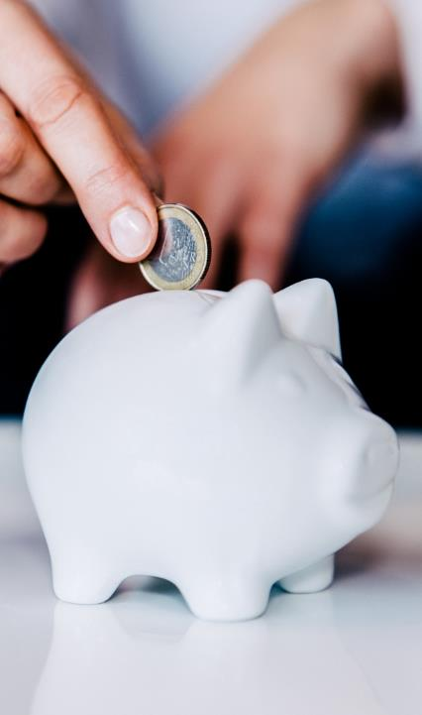

PEOPLE
PROFIT
PLANET
Notes:
People, profit, Planet. Or how can it saves money uses less raw materials and improves the well being of people

Slide 6
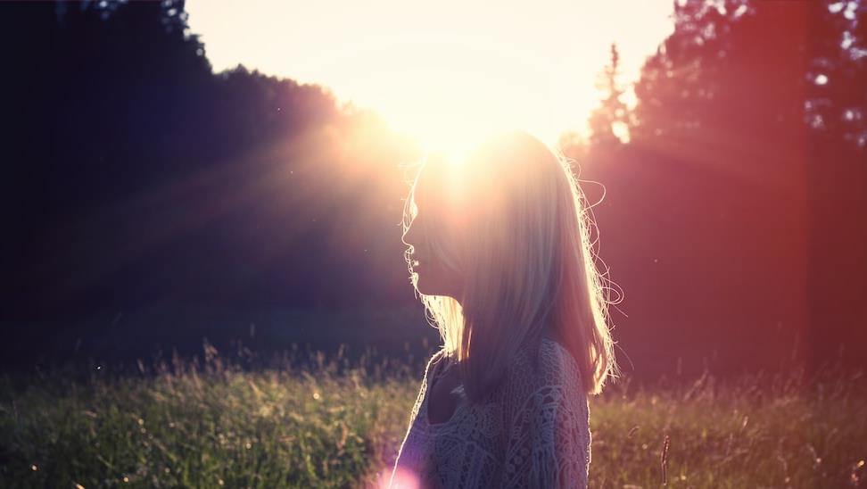
PEOPLE – WELL BEING
Notes:
The impact of light on human being is huge. I don’t know how happy you feel about switching back to summertime, that we have more light again. What a sunrise can do with us. The power of light, is the power of Live

Slide 7

Notes:
Image you have to study all day in a room with no light, how do you feel after such a day. What is your energy level. We are spending 80 % of the time inside (during summer it’s less).

Slide 8
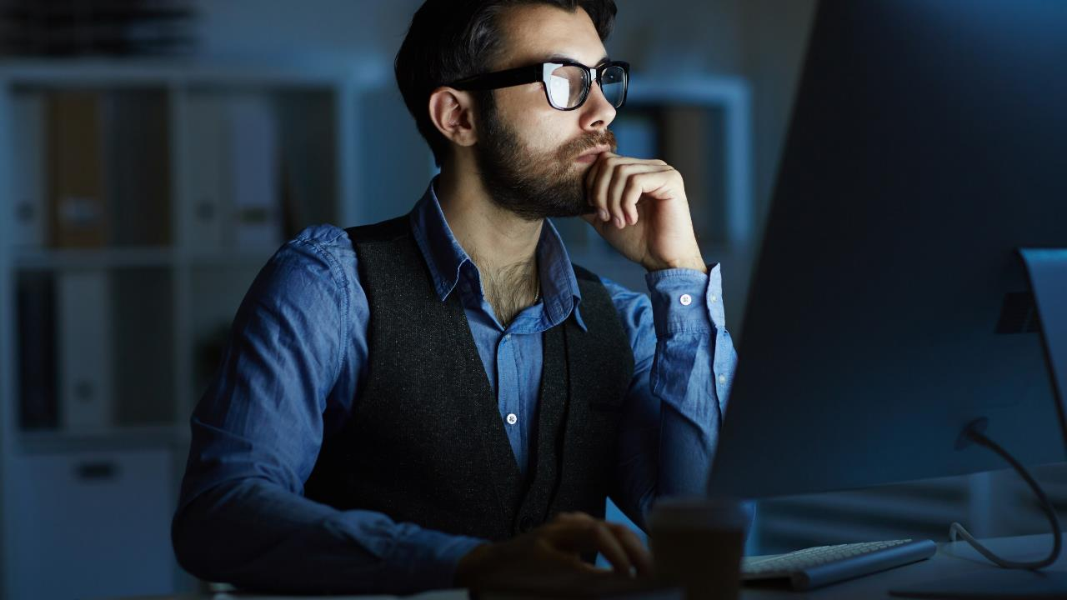
Gemiddeld, zijn we meer dan 90% van ons tijd binnen
Notes:
Een Smart Building is niet alleen slim, het moet ook duurzaam zijn en het moet ook een gezonde werkplek aanbieden.
Gezonde lucht is belangrijk. Vermijden van lawaai is belangrijk.
Maar ook het belang van licht mag niet onderschat worden. Want licht doet veel meer dan ons helpen zien. Het heeft invloed op hoe we ons voelen en hoe we functioneren.
Er is steeds meer wetenschappelijk inzicht is in hoe licht ons slaap/waak ritme bepaald, hoe het de interne klok ook onze organen regelt, wat het effect is op ons metabolisme, herstelproces, hartslag en bloeddruk...
Dat is ook niet zo vreemd, we zijn nog altijd biologische wezens die duizenden jaren buiten hebben geleefd, op het ritme van de zon.
En wat doen wij vandaag? We spenderen 90% van onze tijd binnen, 36% daarvan op ons werk. Bovendien vliegen kriskras over de aarde, tweemaal per jaar verzetten we pardoes de klok, we socializen als we eigenlijk zouden moeten slapen en turen ’s avonds, als het zonlicht allang verdwenen is, nog urenlang op te blauwe schermpjes.
Hoe zorgen we ervoor dat kunstlicht ons welzijn ondersteunt?

Slide 9
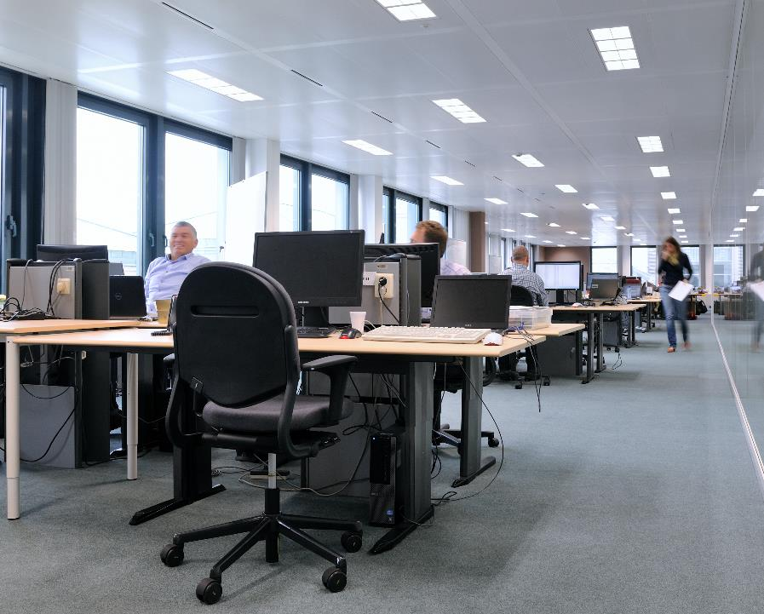
Nieuwe norm EN 12464-1 (2021) sinds 1/03/2022
Voor meer
1. Visueel comfort
2. Visuele prestatie
3. Veiligheid

Slide 10

Notes:
What if we bring natural light in a room. That you feel the same energy, that you give exactly the same feeling inside a room

Slide 11
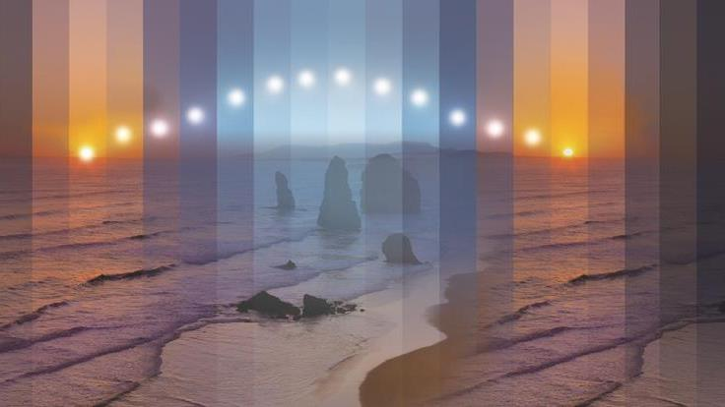
Nature
Connect
Notes:
We simulate the biological clock. It can help people to sleep better. Take the example of a rest home. Every body knows if you visit a rest home, you have warm light, cozy, ….but what happens at 6 oclok in the afternoon, exactly people are falling a sleep, and then at nine we have to give the elderly medicines to fall a sleep. We see that we can avoid 25 % of those pills
Circadian rhytme, regulating the daily cycle

Slide 12
PEOPLE
PROFIT
PLANET
Notes:
Next to the wellbeing of people we can win a lot of money by changing the lamp

Slide 13
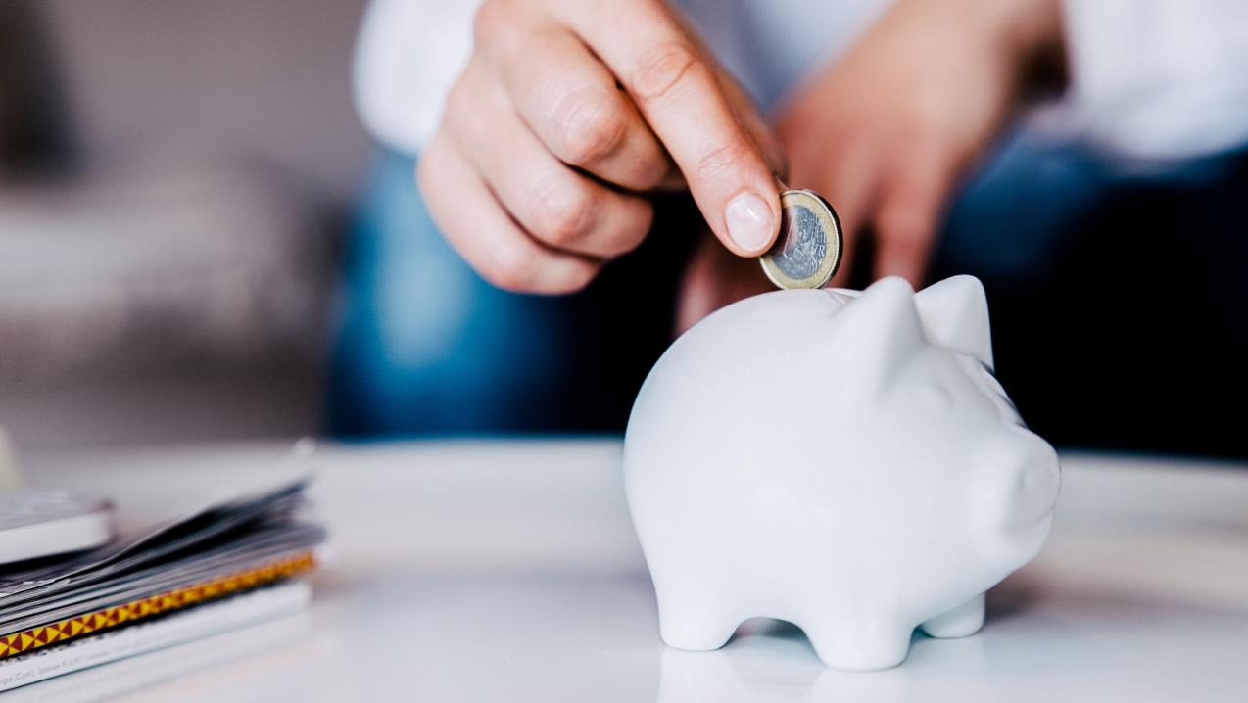
PROFIT

Slide 14
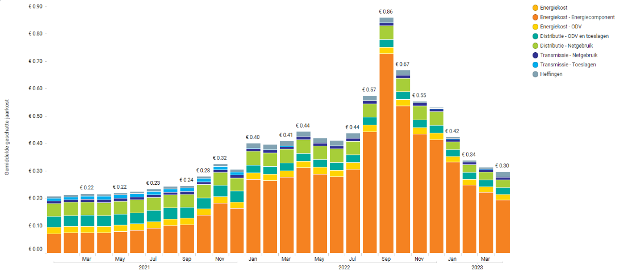
Energy costs are still 50% higher than in Q1 2021

Slide 15
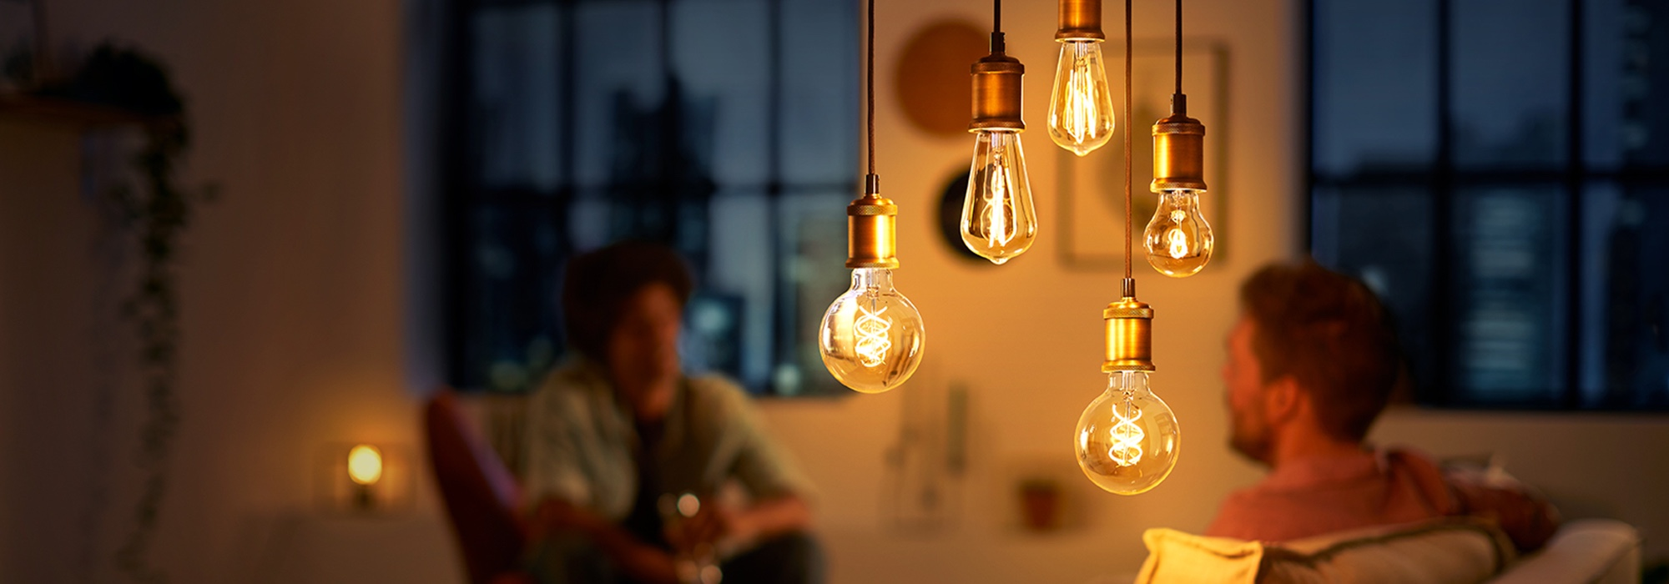
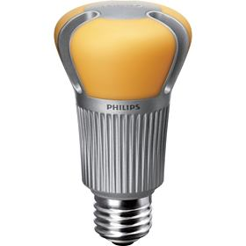
LED
Notes:
This is how the first LED lamp looked like in 2006. Awfull. But let be honest, we improved a lot
We need to do beter than a bulb or candle light.

Slide 16
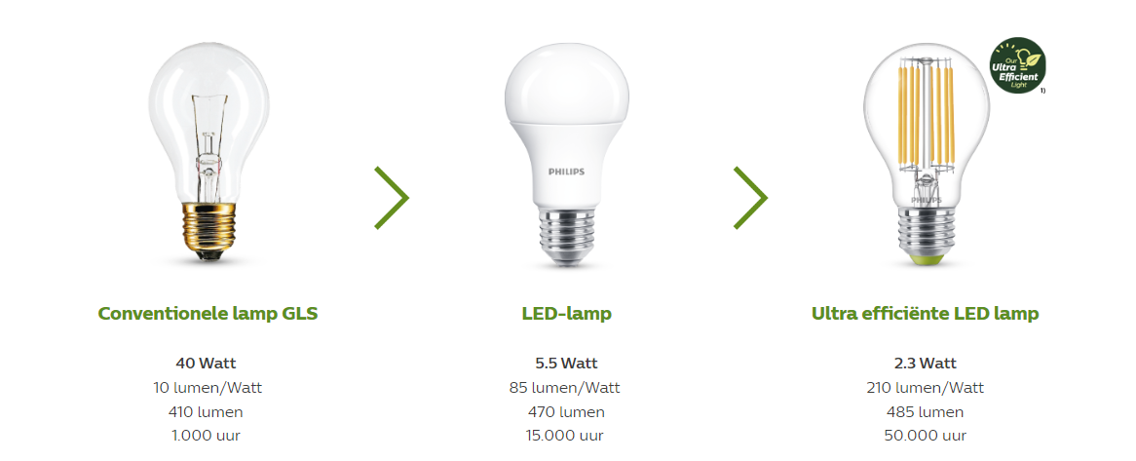
- 85%
Minder energieverbruik

Slide 17
- 60%
Minder energieverbruik
Notes:
Ultra efficient LED lamp, using 60 % less energy than previous led lamps

Slide 18
30€/ year
Notes:
The movement is easy. You turn your hand and save 30 euro. It’s the same movement of drinking a glass

Slide 19




Lighting is the quickest path to greener and smarter world
Education
22 tCO₂ | €39 mln
Switching all Public indoor light points in Belgium to LED, could annually reduce emission by >75 tonnes of CO2, saving >€130 Million in energy costs
Municipal Buildings
14 tCO₂ | €25 mln
Offices
40 tCO₂ | €70 mln
Thousands separator is . - Decimal separator is ,
The diagram represents a selection of light points' applications in the EU27 countries. Data presented here is a simulation within the framework of the Europe Green Switch conventional light point conversion model, which is a program run by Signify to help its customers accelerate the switch to energy-efficient lighting products, systems and services. All figures and data presented here are illustrative and based on forecasts and assumptions.
Price of Electricity Corporations (€/kWh) = 0,297, Price of Electricity Households (€/kWh) = 0,449
Notes:
Saving for Belgium huge
Do you have any idea how many electric cars we can drive with the energy we save to convertall conventional lamps to led. 1.2M (we have at the moment 100K e cars in Belgium), we free up energy for the coming years.
Another thing, at this moment the European Union is investing 50 million LED lamps for Ukraine. Each family will ge 8 LED lamps, the other option was to rebuild two power stations

Slide 20

Fluo ban - regulation
RoHS = Restriction of Hazardous Substances
 | 2022 | 25.02.2023 RoHS¹ | 25.08.2023 RoHS¹ | 01.09.2023 Ecodesign (SLR²)
Regelgeving / Richtlijn
Compact fluorescentielampen
(zonder geïntegreerd voorschakelapparaat)
Cirkelvormige TL-lampen T5
Lineaire TL-lampen T5
Lineaire TL-lampen T8
Hoogvolt halogeenlampen (G9)
Laagsvolt halogeenlampen (G4, GY6.35)
Andere lampen die niet onder het verbod vallen (UV-lampen, TL mini, SON, CDM etc.)
¹ Restriction of the use of certain Hazardous Substances
² Single Lighting Regulation
Notes:
En die verandering moet ook NU gebeuren, want oude TL verlichting wordt vanaf dit jaar verboden.

Slide 21
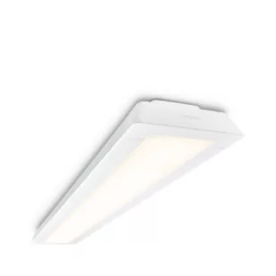
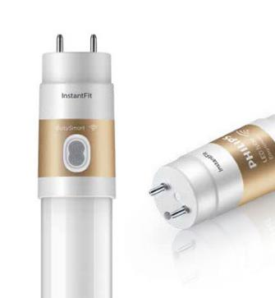
For every situation a suitable solution
TL lighting
Re-Lamping
Re-Lighting
Good
Better
Best
Useful if a building will be divested within coming 2 years
Choose for rotating socket
No ideal lightdistribution
Efficiency (fixture)
+15%
+15%
Lifetime (fixture)
50 000h
L70B50
+40%
70 000h
L70B50
Extras
Higher light comfort
Higher CRI
Wieland plug
Notes:
Foto relamping: LED tube Instant fit T8 – Foto Relighting: Flexblend armatuur SM340C

Slide 22
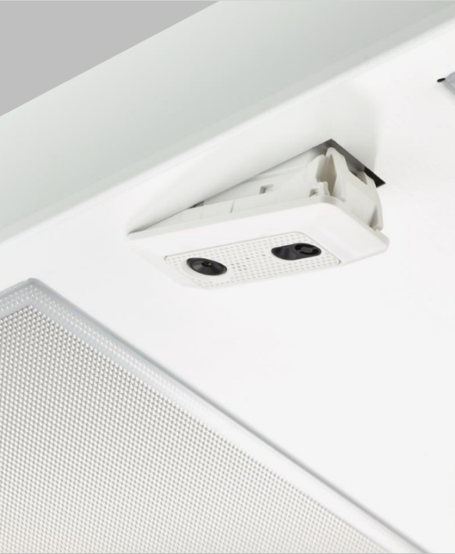
Extra savings with daylight harvesting & presence detection
Step 2:
LED + Sensors
Step 1: LED
Extra 50%
t.o.v. Stap 1
Today’sTL
>65%
Full LEDification:
>65% energy savings
50% extra energy savings with daylight & presence detection

Slide 23
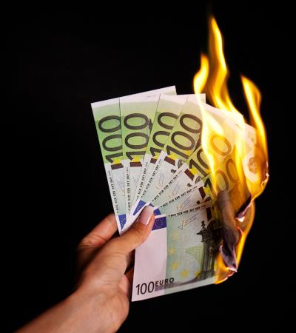
Till 700 Euro per room are burned every year with conventionele verlichting
2800h/year | 4000h/year
521€/year | 740€/year
Size of room: +/- 43m²
9 lighting fixtures with 2xTL5 36W => LED
Including sensors (daylight & presence detection)
Energy costs: 0,35€/kWh

Slide 24
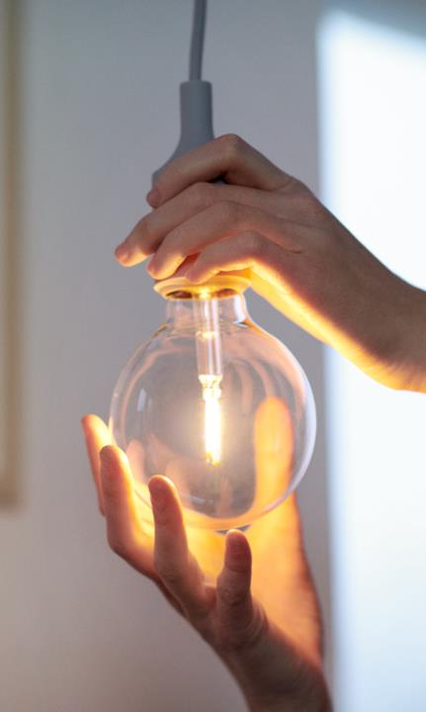
PEOPLE
PROFIT
PLANET
Notes:
What happened on last Sunday, 26 of March It was earth overshoot day of Belgium. It means the day that we are using more materials from mother earth that It can reproduce for one year. So we consumed more in 3 months than that the planet can recover in a year. We need to treat our raw materials better.

Slide 25

PLANET
Notes:
What happened on last Sunday, 26 of March It was earth overshoot day of Belgium. It means the day that we are using more materials from mother earth that It can reproduce for one year. So we consumed more in 3 months than that the planet can recover in a year. We need to treat our raw materials better.

Slide 26





Our way to Circular Lighting
Design for a circular economy
extracting
raw materials
parts supply
recycle
manufacturing
parts harvesting
refurbish
distribution
service
Circular
incineration
& landfill
user
Notes:
The current economic model of take-make-waste isn’t sustainable. We need to do it different.

Slide 27
5 criteria for Circular Lighting
Energy Efficiency & Lifespan: In lighting, energy consumption accounts for more than 90% of the total lifecycle carbon footprint, along with expected lifespan, is the most important lever
Serviceable: is the ability to extend the technical and economic life of the product
Connectable: Luminaires with a sensor or data connection can be connected to a system outside the luminaire.
Upgradable: Lifetime extension through performance upgrades and extended functionality
Reusable & recyclable : Luminaires and components can be reused; materials are recovered with minimal waste

Slide 28
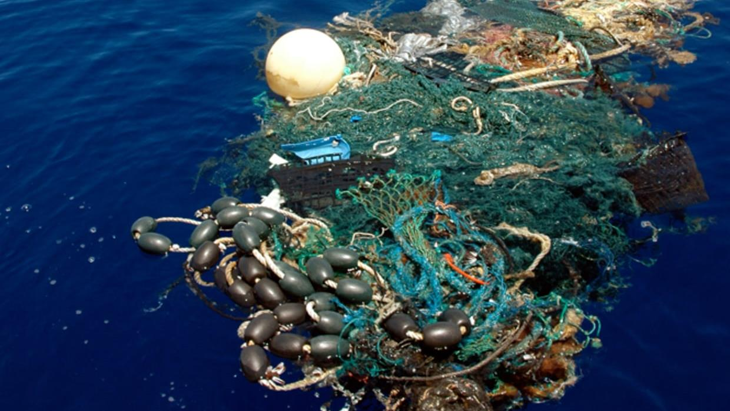
3
Using waste
to create products
Notes:
Grondstoffen zijn schaars
Minder afval

Slide 29
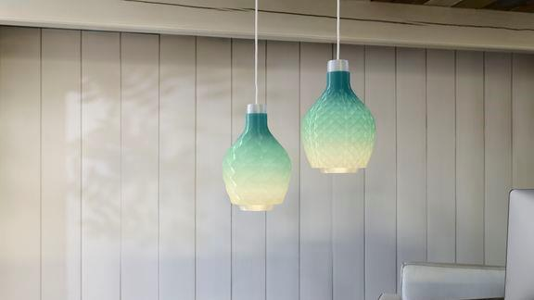
Waste to Wonder
Notes:
From waste to wonder
100% recycled fishing nets

Slide 30
PEOPLE
PROFIT
PLANET
Notes:
People, profit, Planet. Or how can it saves money uses less raw materials and improves the well being of people

Slide 31
For happier people!
For lower costs!
For a healthier planet!

